Slide 1
Feature detection and matching - Edges

Slide 2
Objectives
Learn the concept of edge, edge detection
Techniques used in edge detection
Understand the concept of Edge linking
What are application of edge detection?

Slide 3
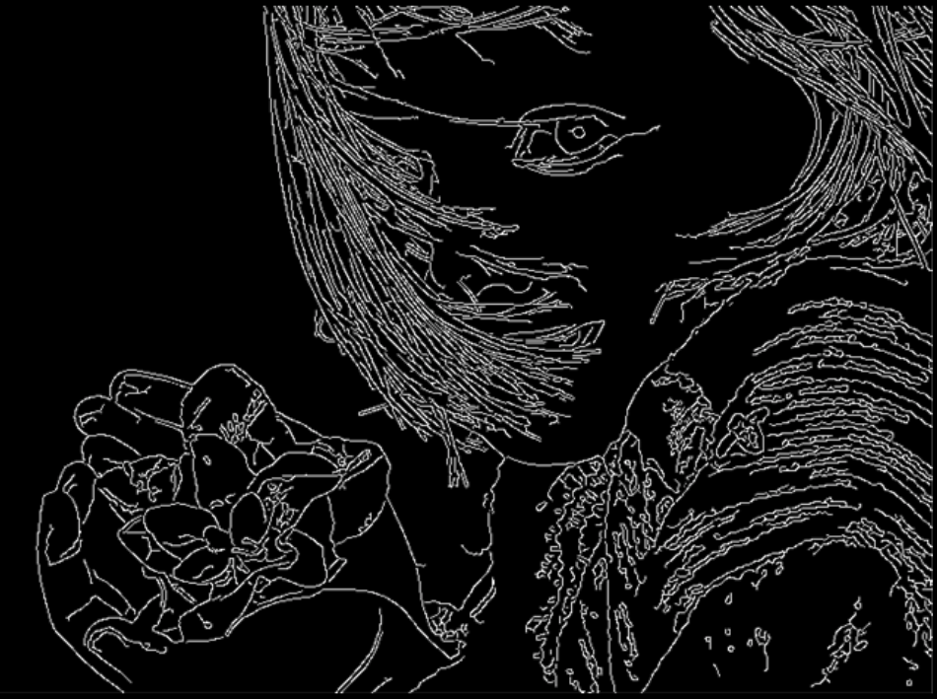
What is edge in image?
Edges are significant local changes of intensity in a digital image.
An edge can be defined as a set of connected pixels that forms a boundary between two disjoint regions.
Three types of edges:
Horizontal edges
Vertical edges
Diagonal edges
Notes:
These points where the image brightness varies sharply are called the edges (or boundaries) of the image.

Slide 4
What is edge detection?
Edge detection is a technique of image processing used to identify points in a digital image with discontinuities ~ sharp changes in the image brightness.
Edge Detection is a method of segmenting an image into regions of discontinuity.
Edge detection allows users to observe the features of an image for a significant change in the gray level.
It reduces the amount of data in an image and preserves the structural properties of an image.

Slide 5
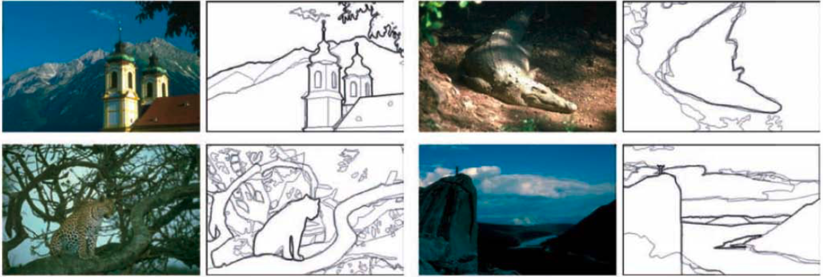
What is edge detection?
Notes:
Human boundary detection (Martin, Fowlkes, and Malik 2004) ⃝c 2004 IEEE. The darkness of the edges corresponds to how many human subjects marked an object bound- ary at that location.

Slide 6
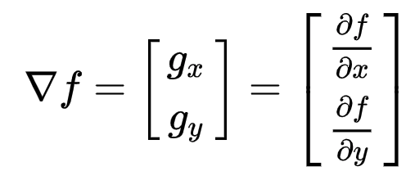
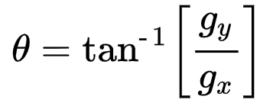
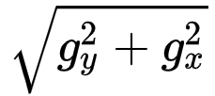
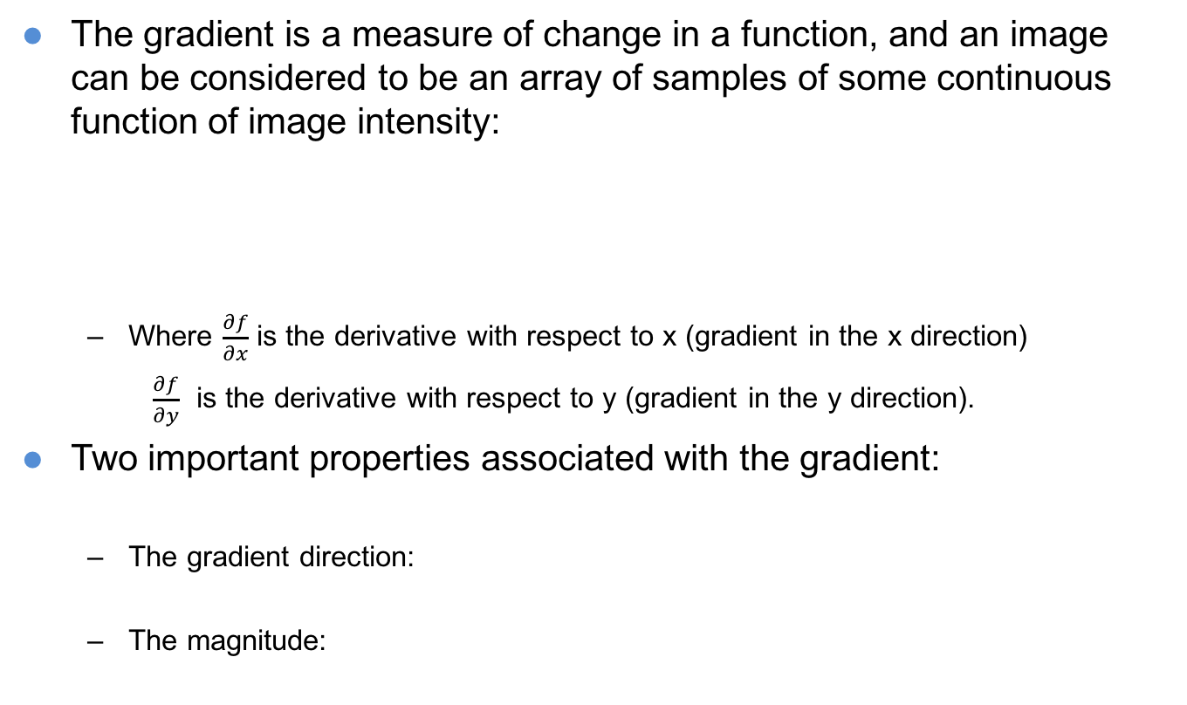
Edge in Mathematical
The gradient is a measure of change in a function, and an image can be considered to be an array of samples of some continuous function of image intensity:
Where $\frac{∂f}{∂x}$ is the derivative with respect to x (gradient in the x direction)
$\frac{∂f}{∂y}$ is the derivative with respect to y (gradient in the y direction).
Two important properties associated with the gradient:
The gradient direction:
The magnitude:

Slide 7
Edge detection’s steps
Filtering: filtering is commonly used to improve the performance of an edge detector with respect to noise- noise reduction
Enhancement: Enhancement emphasizes pixels where there is a significant change in local intensity value- edge sharpening
Detection: determine which points are edge points- Thresholding
Localization: The location of the edge- determine the exact location of an edge- use edge thinning and edge linking
→ The errors in edge detection are errors of misclassification: false edges and missing edges.

Slide 8
Edge detection
Two types of Edge Detection:
Gradient – based operator which computes first-order derivations in a digital image like, Sobel operator, Prewitt operator, Robert operator
Gaussian – based operator which computes second-order derivations in a digital image like, Canny edge detector, Laplacian of Gaussian
Edge Detection applications:
medical imaging, study of anatomical structure
locate an object in satellite images
automatic traffic controlling systems
face recognition, and fingerprint recognition

Slide 9
Edge detection - Sobel operator
It computes the gradient approximation of image intensity function for image edge detection. At the pixels of an image, the Sobel operator produces either the normal to a vector or the corresponding gradient vector.
It uses two 3 x 3 kernels or masks which are convolved with the input image to calculate the vertical and horizontal derivative approximations respectively.
Advantages:
Simple and time-efficient computation
Very easy at searching for smooth edges
Limitations:
Highly sensitive to noise
Not very accurate in edge detection

Slide 10
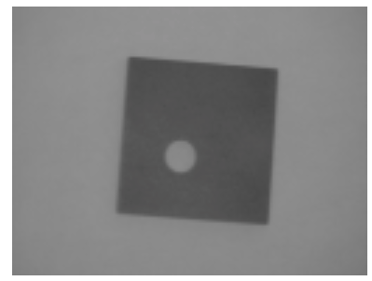
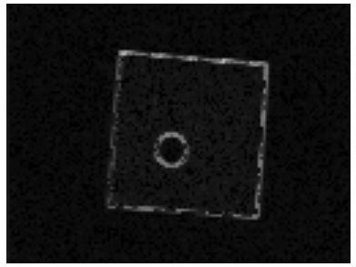
Edge detection - Sobel operator
-1 | 0 | +1
-2 | 0 | +2
-1 | 0 | +1
-1 | -2 | -1
0 | 0 | 0
+1 | +2 | +1
Gx
Gy

Slide 11
Edge detection - Prewitt operator
It also detects vertical and horizontal edges of an image.
It is one of the best ways to detect the orientation and magnitude of an image.
Advantages:
Good performance on detecting vertical and horizontal edges
Best operator to detect the orientation of an image
Limitations:
The magnitude of coefficient is fixed and cannot be changed
Diagonal direction points are not preserved always

Slide 12
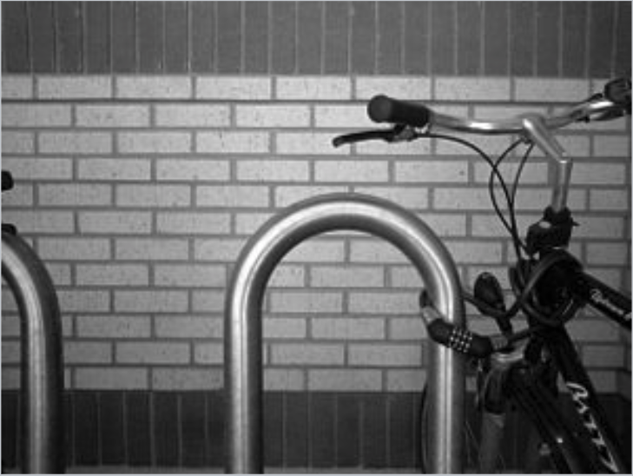
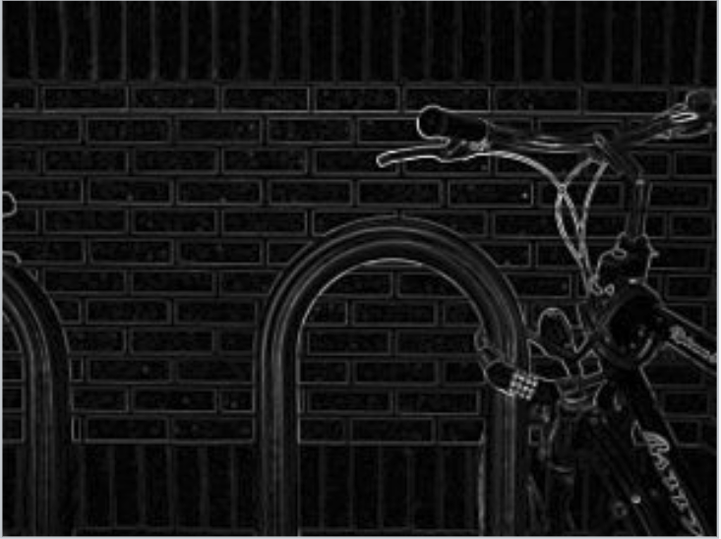
Edge detection - Prewitt operator
-1 | 0 | +1
-1 | 0 | +1
-1 | 0 | +1
-1 | -1 | -1
0 | 0 | 0
+1 | +1 | +1
Gx
Gy
Notes:
Gradient with Prewitt operator of grayscale image of a brick wall & a bike rack

Slide 13
Edge detection - Robert operator
This gradient-based operator computes the sum of squares of the differences between diagonally adjacent pixels in an image through discrete differentiation. Then the gradient approximation is made.
Advantages:
Detection of edges and orientation are very easy
Diagonal direction points are preserved
Limitations:
Very sensitive to noise
Not very accurate in edge detection

Slide 14
Edge detection - Robert operator
+1 | 0
0 | -1
0 | 1
-1 | 0
Gx
Gy
Notes:
Gradient with Prewitt operator of grayscale image of a brick wall & a bike rack

Slide 15
Edge detection - Laplacian of Gaussian
It is a gaussian-based operator which uses the Laplacian to take the second derivative of an image.
This really works well when the transition of the grey level seems to be abrupt. It works on the zero-crossing method i.e when the second-order derivative crosses zero, then that particular location corresponds to a maximum level.
The Gaussian operator reduces the noise and the Laplacian operator detects the sharp edges.

Slide 16
Edge detection - Laplacian of Gaussian
Advantages:
Easy to detect edges and their various orientations
There is fixed characteristics in all directions
Limitations:
Very sensitive to noise
The localization error may be severe at curved edges
It generates noisy responses that do not correspond to edges

Slide 17
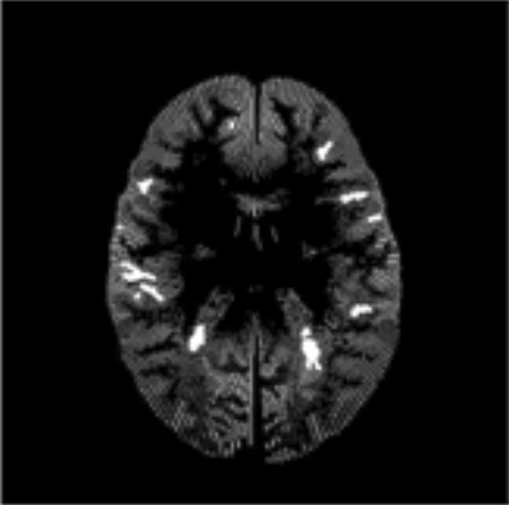
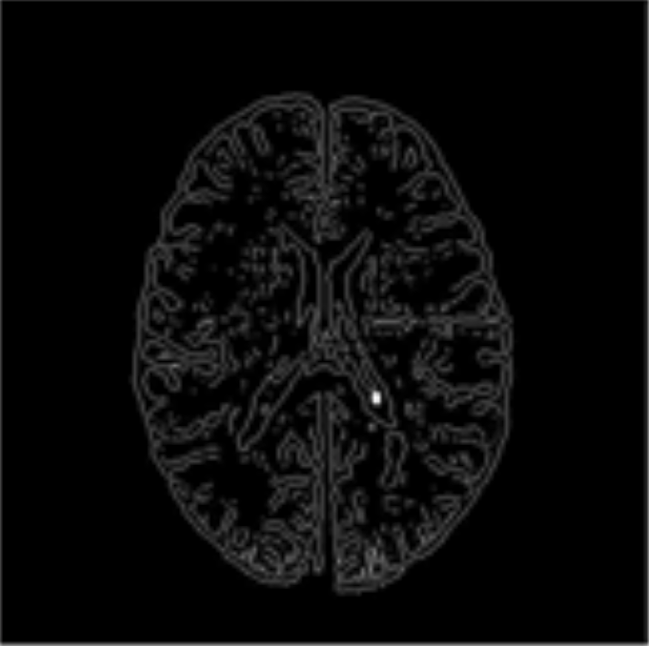
Edge detection - Laplacian of Gaussian
Mar- Hildrethedge detection
Sobel edge detection
Notes:
Gradient with Prewitt operator of grayscale image of a brick wall & a bike rack

Slide 18
Edge detection - Canny Operator
It is a gaussian-based operator in detecting edges.
This operator is not susceptible to noise.
It extracts image features without affecting or altering the feature.
Canny edge detector have advanced algorithm derived from the previous work of Laplacian of Gaussian operator.
It is widely used an optimal edge detection technique.

Slide 19
Edge detection - Canny Operator
It detects edges based on three criteria:
Low error rate
Edge points must be accurately localized
There should be just one single edge response
Advantages:
It has good localization
It extracts image features without altering the features
Less Sensitive to noise
Limitations:
There is false zero crossing
Complex computation and time consuming

Slide 20
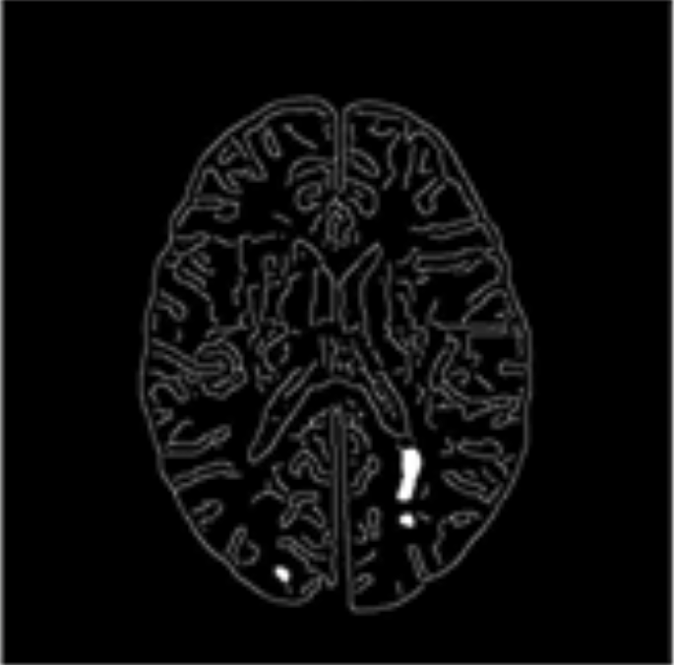
Edge detection - Canny Operator
Mar- Hildrethedge detection
Sobel edge detection
Candy edge detection
Notes:
Gradient with Prewitt operator of grayscale image of a brick wall & a bike rack

Slide 21
Edge Link
Edge linking process takes an unordered set of edge pixels produced by an edge detector as an input to form an ordered list of edges.
Local edge information are utilized by edge linking operation; thus edge detection algorithms typically are followed by linking procedure to assemble edge pixels into meaningful edges.
edges have been detected using zero crossings of some function, linking them up is straightforward, since adjacent edges share common endpoints.
Linking the edges into chains involves picking up an unlinked edge and following its neighbors in both directions.

Slide 22
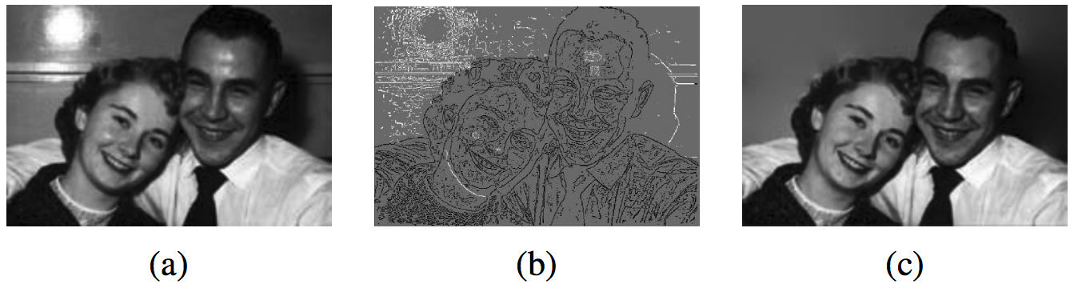
Application: Edge editing
Edge is used directly for image editing. It allows users to selectively remove edges corresponding to unwanted features such as specularities, shadows, or distracting visual elements. After reconstructing the image from the remaining edges, the undesirable visual features have been removed

Slide 23
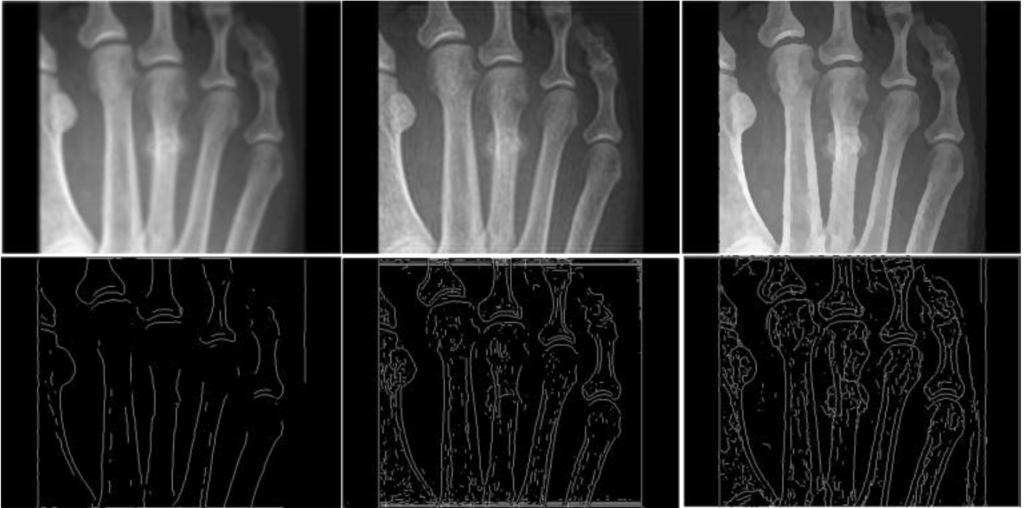
Application: Edge enhancement
Another potential application is to enhance perceptually salient edges while simplifying the underlying image to produce a cartoon-like or “pen-and-ink” stylized image
Notes:
Comparison of edge enhancement result. (a) Blurred image; (b) L-R result; (c) Shock result.

Slide 24
Summary
Learn the concept of edge, edge detection
Techniques used in edge detection
Understand the concept of Edge linking
What are application of edge detection.

